Slide 1
Innovative methods to determine molecular spectra

Slide 2

What is quantum chemistry?
A branch of physical chemistry focused on the application of quantum mechanics to chemical systems to predict the contribution of electronic systems to physical and chemical properties of molecules, materials and solutions at the atomic level.

Slide 3
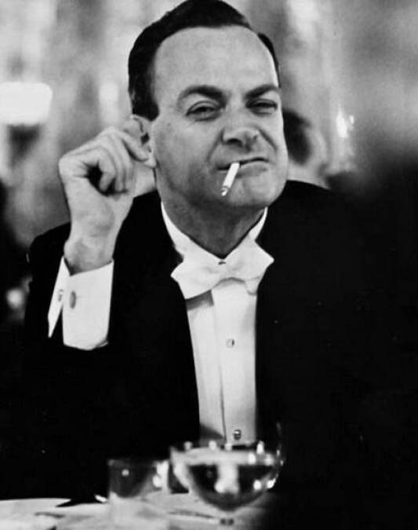
What is quantum chemistry?
“Nature isn't classical, dammit, and if you want to make a simulation of nature, you'd better make it quantum mechanical”
Richard P. Feynman
Notes:
Aggiungere il discorso riguardante i limiti computazionali a livello di risorse hardware clasiche e tempi.

Slide 4
Solution of a quantum chemistry problem
The idea
Molecular system
H
Ansatz
Algorithm
Algorithm
Spectrum
States

Slide 5
Our work
I. Provide an implementation of the RODEO algorithm
II. Propose an alternative algorithm to retrieve the whole energy spectrum of a molecular system
III. Illustrate the differences between the outcomes of the two algorithms test-benched over the same hamiltonians

Slide 6
Our work
Why?
Many algorithms able to determine the ground state energy of a quantum system
Quantum phase estimation
Quantum annealing
...
No established algoritmhs to build the whole spectrum!

Slide 7
OUTLINE
The Rodeo Algorithm
RODEO Implementation & Results
Variational Quantum Deflation (VQD)
VQD Implementation & Results
Comparison
Conclusions

Slide 8
The RODEO Algorithm

Slide 9
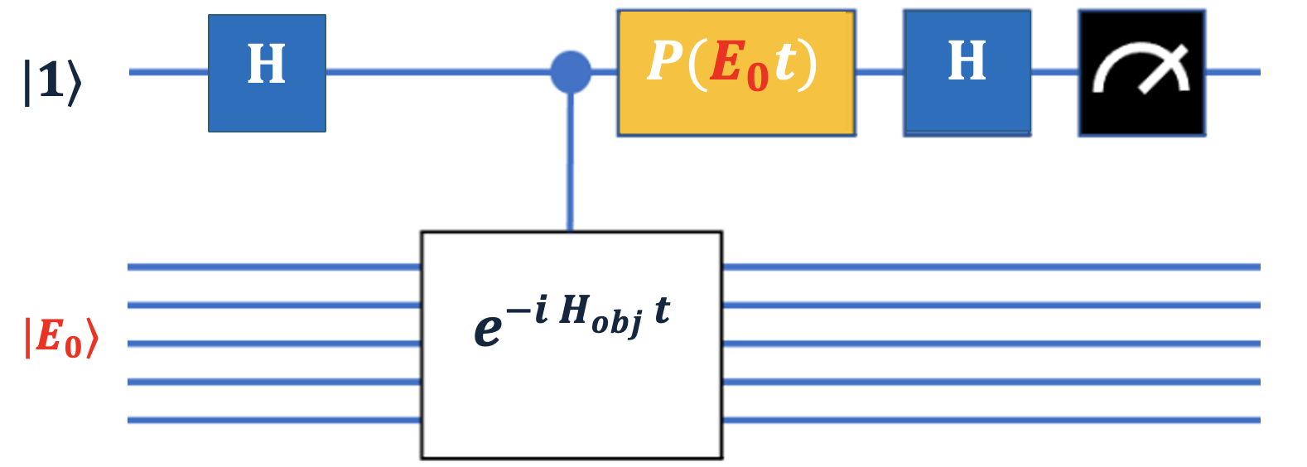
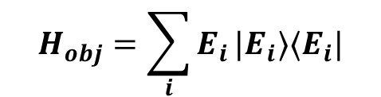

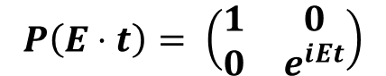
The RODEO Algorithm
Preliminary Example
Exploit phase​ kickback in controlled-Hamiltonian evolution.
Objective Hamiltonian:
Parametrized Phase Rotation:
$$\left|1\right\rangle |E_{0}⟩$$
$$H_{obj}=\sum_{i}{E_{i}}|E_{i}⟩⟨E_{i}|$$
$$P\left(E⋅t\right)= \left(\begin{matrix}1 & 0 \\ 0 & e^{iEt}\end{matrix}\right)$$

Slide 10
The RODEO algorithm
Idea
Exploit phase​ kickback in controlled-Hamiltonian evolution.
Objective Hamiltonian:
Parametrized Phase Rotation:
$$\left|1\right\rangle |E_{0}⟩$$
$$H_{obj}=\sum_{i}{E_{i}}|E_{i}⟩⟨E_{i}|$$
$$P\left(E⋅t\right)= \left(\begin{matrix}1 & 0 \\ 0 & e^{iEt}\end{matrix}\right)$$
Hamiltonian Simulation

Slide 11
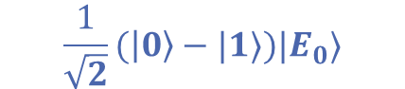
The RODEO Algorithm
Preliminary Example
Idea
Exploit phase​ kickback in controlled-Hamiltonian evolution.
Objective Hamiltonian:
Parametrized Phase Rotation:
$$\frac{1}{\sqrt{2}}(\left|0\right\rangle −|1⟩)|E_{0}⟩$$
$$H_{obj}=\sum_{i}{E_{i}}|E_{i}⟩⟨E_{i}|$$
$$P\left(E⋅t\right)= \left(\begin{matrix}1 & 0 \\ 0 & e^{iEt}\end{matrix}\right)$$
Hamiltonian Simulation

Slide 12
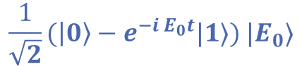
The RODEO Algorithm
Preliminary Example
Idea
Exploit phase​ kickback in controlled-Hamiltonian evolution.
Objective Hamiltonian:
Parametrized Phase Rotation:
$$\frac{1}{\sqrt{2}}(\left|0\right\rangle −e^{−i E_{0}t}|1⟩) |E_{0}⟩$$
$$H_{obj}=\sum_{i}{E_{i}}|E_{i}⟩⟨E_{i}|$$
$$P\left(E⋅t\right)= \left(\begin{matrix}1 & 0 \\ 0 & e^{iEt}\end{matrix}\right)$$

Slide 13
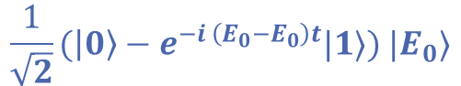
The RODEO Algorithm
Preliminary Example
Idea
Exploit phase​ kickback in controlled-Hamiltonian evolution.
Objective Hamiltonian:
Parametrized Phase Rotation:
$$\frac{1}{\sqrt{2}}(\left|0\right\rangle −e^{−i \left(E_{0}−E_{0}\right)t}|1⟩) |E_{0}⟩$$
$$H_{obj}=\sum_{i}{E_{i}}|E_{i}⟩⟨E_{i}|$$
$$P\left(E⋅t\right)= \left(\begin{matrix}1 & 0 \\ 0 & e^{iEt}\end{matrix}\right)$$

Slide 14
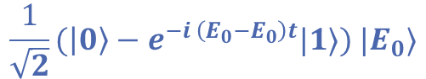

The RODEO Algorithm
Preliminary Example
Idea
Exploit phase​ kickback in controlled-Hamiltonian evolution.
Objective Hamiltonian:
Parametrized Phase Rotation:
$$1$$
$$\frac{1}{\sqrt{2}}(\left|0\right\rangle −e^{−i \left(E_{0}−E_{0}\right)t}|1⟩) |E_{0}⟩$$
$$H_{obj}=\sum_{i}{E_{i}}|E_{i}⟩⟨E_{i}|$$
$$P\left(E⋅t\right)= \left(\begin{matrix}1 & 0 \\ 0 & e^{iEt}\end{matrix}\right)$$

Slide 15

The RODEO Algorithm
Preliminary Example
Idea
Exploit phase​ kickback in controlled-Hamiltonian evolution.
Objective Hamiltonian:
Parametrized Phase Rotation:
$$|1⟩ |E_{0}⟩$$
$$H_{obj}=\sum_{i}{E_{i}}|E_{i}⟩⟨E_{i}|$$
$$P\left(E⋅t\right)= \left(\begin{matrix}1 & 0 \\ 0 & e^{iEt}\end{matrix}\right)$$

Slide 16

The RODEO Algorithm
Preliminary Example
Idea
Exploit phase​ kickback in controlled-Hamiltonian evolution.
Objective Hamiltonian:
Parametrized Phase Rotation:
$$P_{1}=1$$
$$H_{obj}=\sum_{i}{E_{i}}|E_{i}⟩⟨E_{i}|$$
$$P\left(E⋅t\right)= \left(\begin{matrix}1 & 0 \\ 0 & e^{iEt}\end{matrix}\right)$$

Slide 17
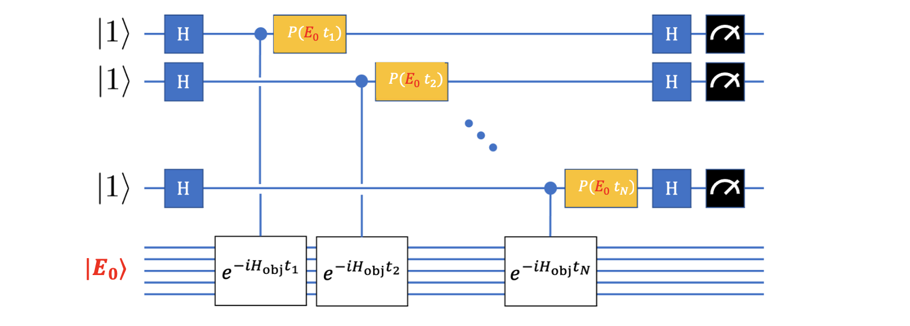

The RODEO Algorithm
Preliminary Example
Idea
More ancillas ($N$) with different time parameters ${\left\{t_{n}\right\}}_{n=1}^{N}$
$$P_{N}= 1$$

Slide 18
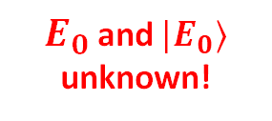
The RODEO Algorithm
Preliminary Example
Idea
More ancillas ($N$) with different time parameters ${\left\{t_{n}\right\}}_{n=1}^{N}$
$E_{0}$ and ${|E}_{0}⟩$ unknown!
RODEO solves both issues

Slide 19

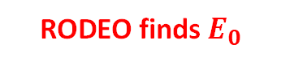

The RODEO Algorithm
Preliminary Example
Idea
More ancillas ($N$) with different time parameters ${\left\{t_{n}\right\}}_{n=1}^{N}$
$E_{0}$ unknown!
Our Work
RODEO finds $E_{0}$
$$≈$$

Slide 20
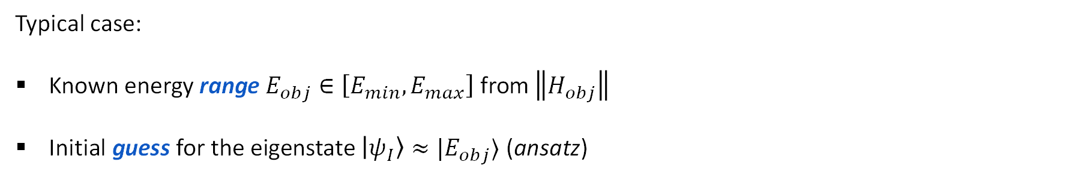
The RODEO Algorithm
The Circuit
Typical case:
Known energy range $E_{obj}∈\left[E_{min}, E_{max}\right]$ from $\left\|H_{obj}\right\|$
Initial guess for the eigenstate $\left|ψ_{I}\right\rangle ≈|E_{obj}⟩$ (ansatz)

Slide 21
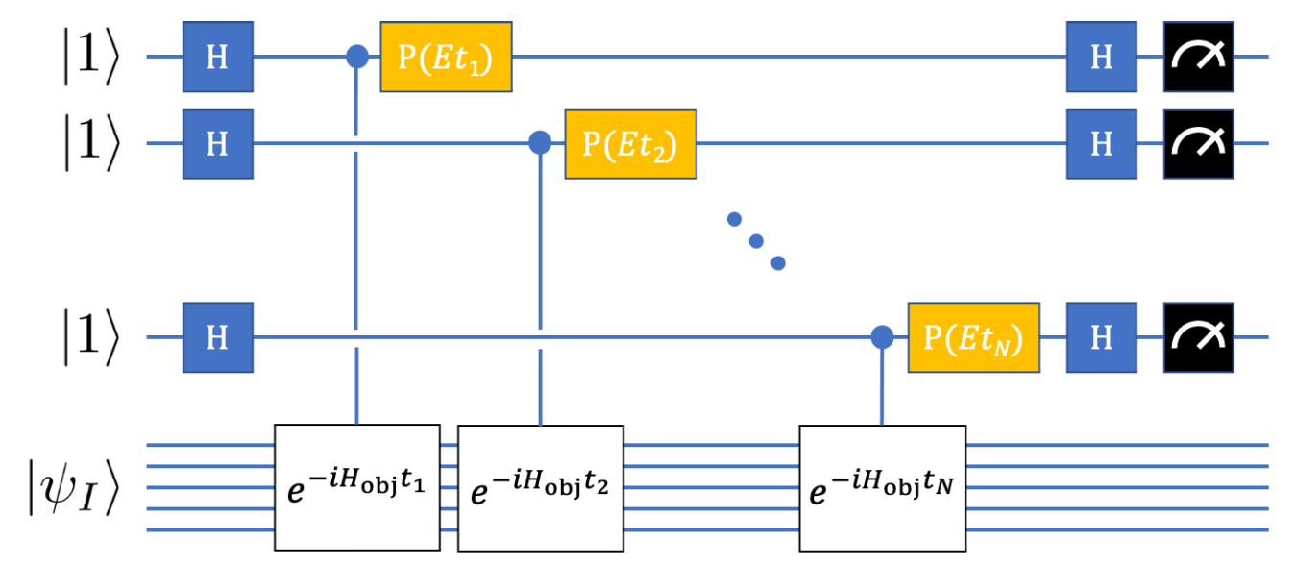
The RODEO Algorithm
The Circuit

Slide 22
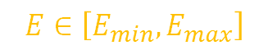
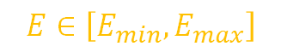
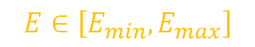
The RODEO Algorithm
The Circuit
$$E∈\left[E_{min}, E_{max}\right]$$
$$E∈\left[E_{min}, E_{max}\right]$$
$$E∈\left[E_{min}, E_{max}\right]$$

Slide 23
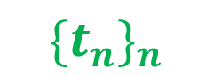
The RODEO Algorithm
The Circuit
$$E∈\left[E_{min}, E_{max}\right]$$
$$E∈\left[E_{min}, E_{max}\right]$$
$$E∈\left[E_{min}, E_{max}\right]$$
$$\{t_{n}\}_{n}$$

Slide 24
The RODEO Algorithm
The Circuit
$$E∈\left[E_{min}, E_{max}\right]$$
$$E∈\left[E_{min}, E_{max}\right]$$
$$E∈\left[E_{min}, E_{max}\right]$$
$$\{t_{n}\}_{n}$$
External Ansatz

Slide 25


The RODEO algorithm
The Circuit
$$E∈\left[E_{min}, E_{max}\right]$$
$$E∈\left[E_{min}, E_{max}\right]$$
$$E∈\left[E_{min}, E_{max}\right]$$
$$???$$
$$???$$
Iterate!

Slide 26
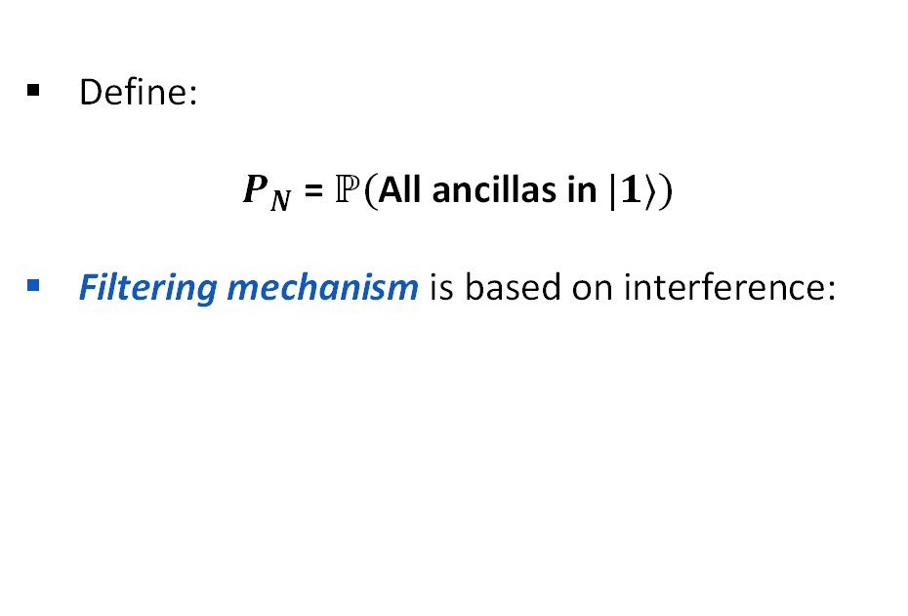
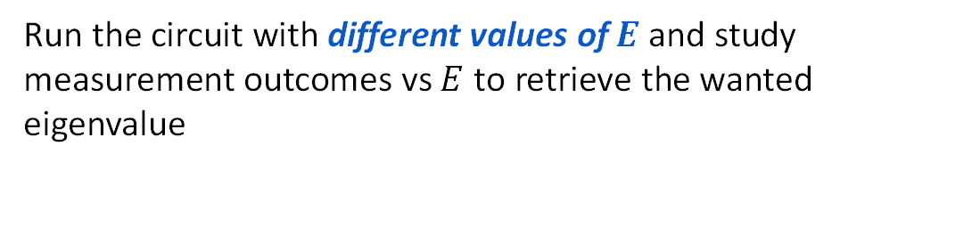
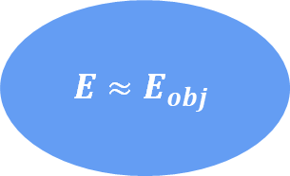
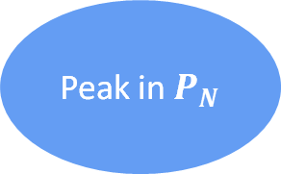
RODEO: Eigenvalue Determination
Idea
Run the circuit with different values of $E$ and study measurement outcomes vs $E$ to retrieve the wanted eigenvalue
Define:
$P_{N}$ = $ℙ($All ancillas in $|1⟩)$
Filtering mechanism is based on interference:
Peak in $P_{N}$
$$E≈E_{obj}$$

Slide 27
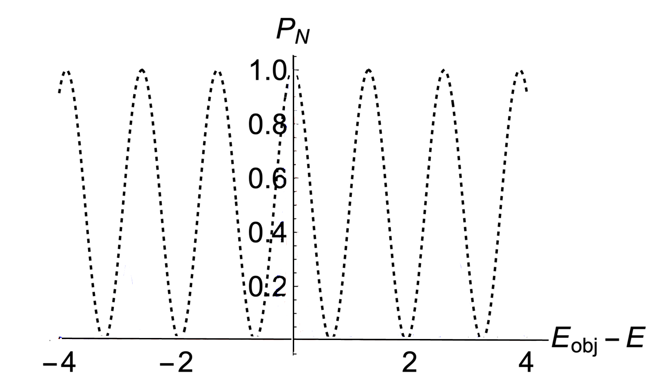
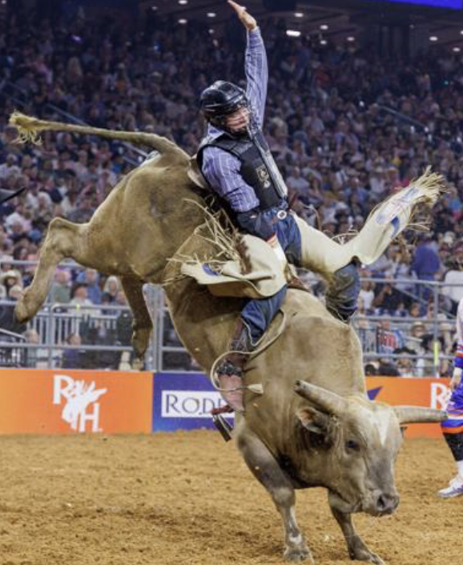
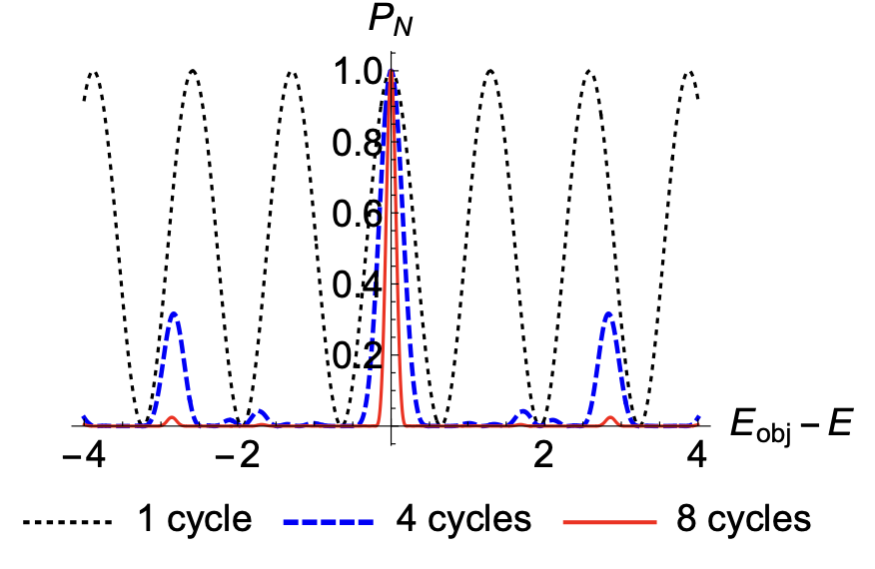
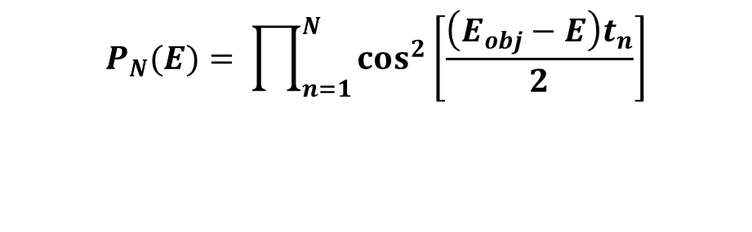
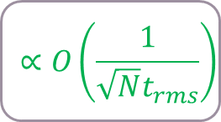
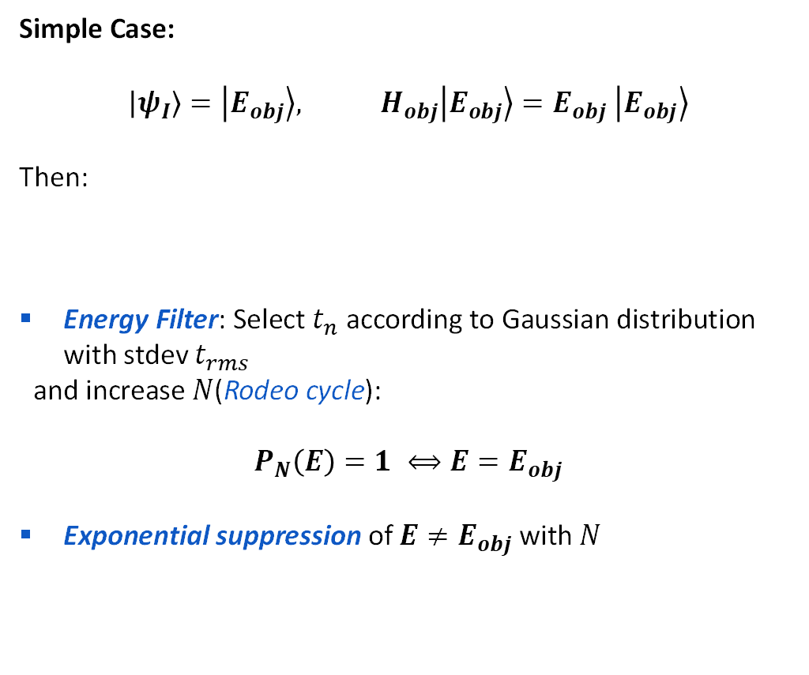
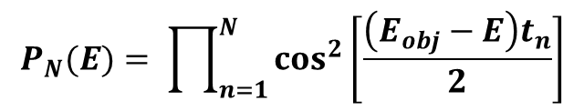

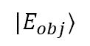

RODEO: Eigenvalue Determination
Case 1: Input Eigenstate
Simple Case:
$$\left|ψ_{I}\right\rangle =\left|E_{obj}\right\rangle , H_{obj}\left|E_{obj}\right\rangle =E_{obj} \left|E_{obj}\right\rangle$$
Then:
Energy Filter: Select $t_{n}$ according to Gaussian distribution with stdev $t_{rms}$
and increase $N$(Rodeo cycle):
$$P_{N}\left(E\right)=1 ⟺E=E_{obj}$$
Exponential suppression of $E≠E_{obj}$ with $N$
$$∝\frac{1}{t}$$
$$P_{N}(E)= \prod_{n=1}^{N}{\cos^{2}\left[\frac{\left(E_{obj}−E\right)t_{n}}{2}\right]}$$
$$P_{N}(E)= \prod_{n=1}^{N}{\cos^{2}\left[\frac{\left(E_{obj}−E\right)t_{n}}{2}\right]}$$
$$P_{1}(E)=\cos^{2}\left[\frac{\left(E_{obj}−E\right)t}{2}\right]$$
$$∝O\left(\frac{1}{\sqrt{N}t_{rms}}\right)$$
$$|E_{obj}⟩$$

Slide 28
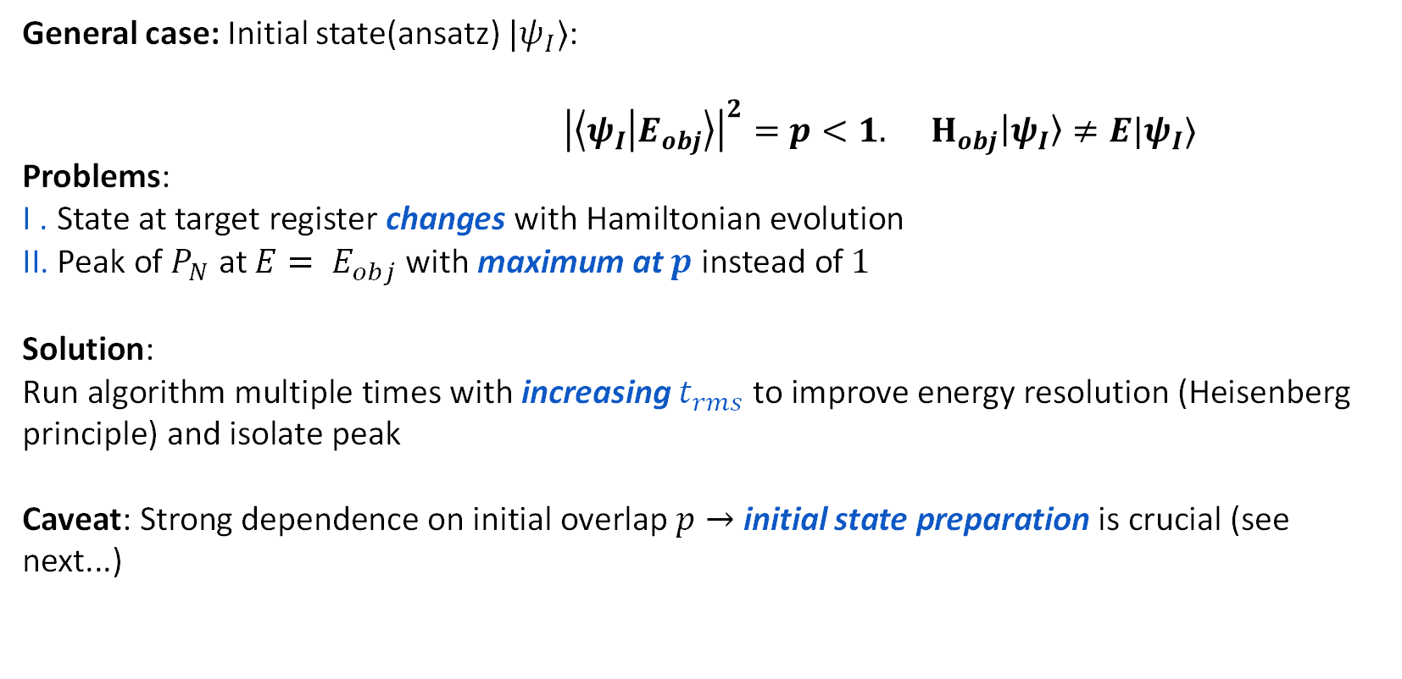
RODEO: Eigenvalue Determination
Case 2: Generic Input
General case: Initial state(ansatz) ${|ψ}_{I}⟩$:
${\left|\left\langle ψ_{I} | E_{obj}\right\rangle \right|}^{2}=p<1. H_{obj}\left|ψ_{I}\right\rangle ≠E|ψ_{I}⟩$
Problems:
I . State at target register changes with Hamiltonian evolution
II. Peak of $P_{N}$ at ${E= E}_{obj}$ with maximum at $p$ instead of $1$
Solution:
Run algorithm multiple times with increasing $t_{rms}$ to improve energy resolution (Heisenberg principle) and isolate peak
Caveat: Strong dependence on initial overlap $p→$ initial state preparation is crucial (see next...)

Slide 29
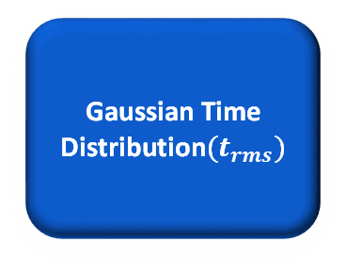
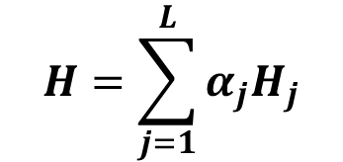
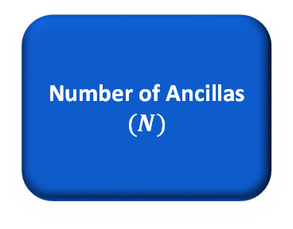
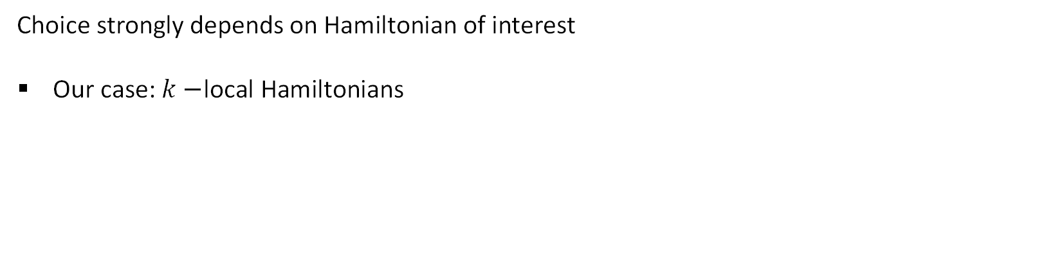
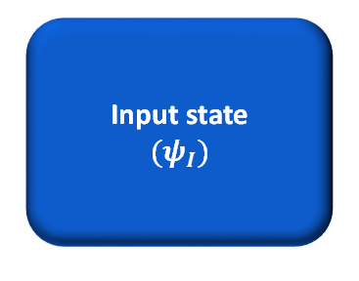
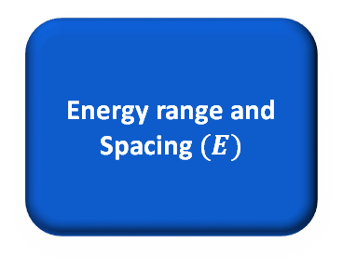
RODEO: Eigenvalue Determination
Summary
Parameter tuning is pivotal in the general case:
Number of Ancillas $(N)$
Gaussian Time Distribution$(t_{rms})$
Energy range and Spacing $(E)$
Input state
$(ψ_{I})$
Choice strongly depends on Hamiltonian of interest
Our case: $k−$local Hamiltonians
$$H=\sum_{j=1}^{L}{α_{j}H_{j}}$$

Slide 30
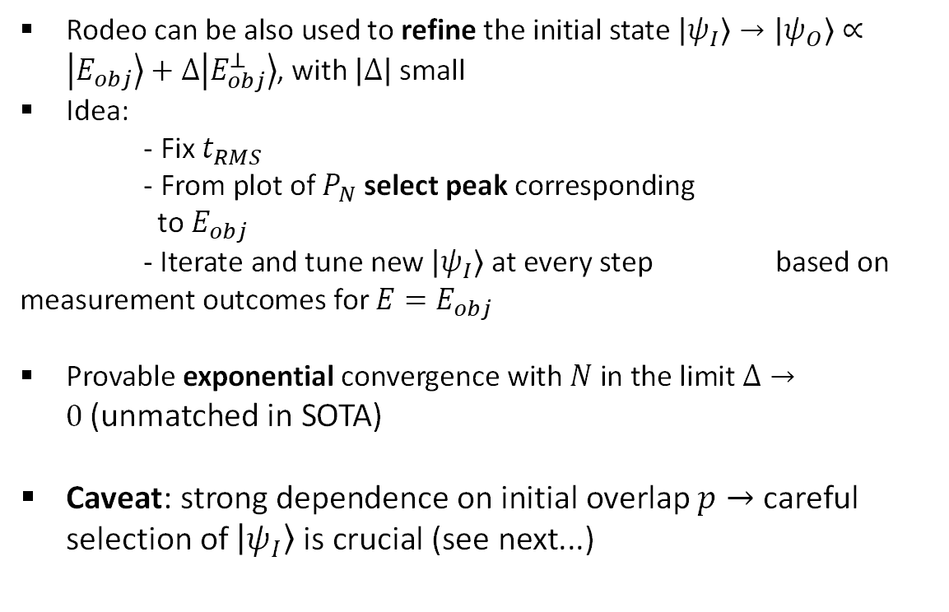

${\text{RODEO}}^{†}$: Finding the State
Initial State Preparation
Rodeo can be also used to refine the initial state $\left|ψ_{I}\right\rangle →\left|ψ_{O}\right\rangle ∝\left|E_{obj}\right\rangle +Δ\left|E_{obj}^{⊥}\right\rangle$, with $\left|Δ\right|$ small
Idea:
- Fix $t_{RMS}$
- From plot of $P_{N}$ select peak corresponding
to $E_{obj}$
- Iterate and tune new $\left|ψ_{I}\right\rangle$ at every step based on measurement outcomes for $E=E_{obj}$
Provable exponential convergence with $N$ in the limit $Δ→0$(unmatched in SOTA)
Caveat: strong dependence on initial overlap $p→$ careful selection of $\left|ψ_{I}\right\rangle$ is crucial (see next...)
Iterate!

Slide 31
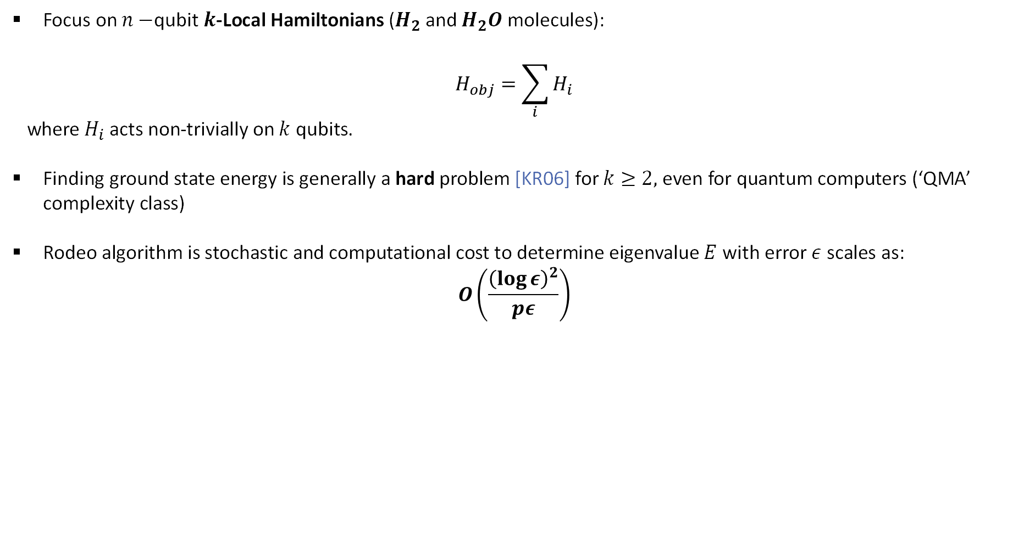
RODEO COMPLEXITY
Ground State Energy Determination
Focus on $n−$qubit $k$-Local Hamiltonians ($H_{2}$ and $H_{2}O$ molecules):
$$H_{obj}=\sum_{i}{H_{i}}$$
where $H_{i}$ acts non-trivially on $k$ qubits.
Finding ground state energy is generally a hard problem [KR06] for $k≥2,$ even for quantum computers (‘QMA’ complexity class)
Rodeo algorithm is stochastic and computational cost to determine eigenvalue $E$ with error $ε$ scales as:
$$O\left(\frac{{\left(\log{ε}\right)}^{2}}{pε}\right)$$

Slide 32
RODEO Implementation

Slide 33



RODEO Implementation
Implementation Intro
PushQuantum
Classiq Challange:
Estimating Molecular Spectra Using the Rodeo Algorithm

Slide 34
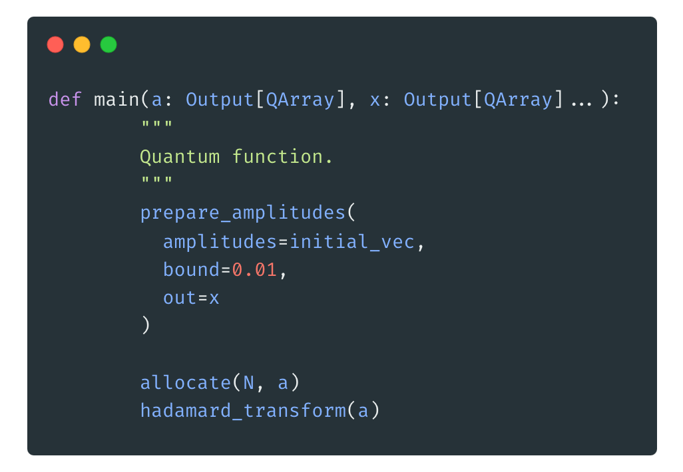
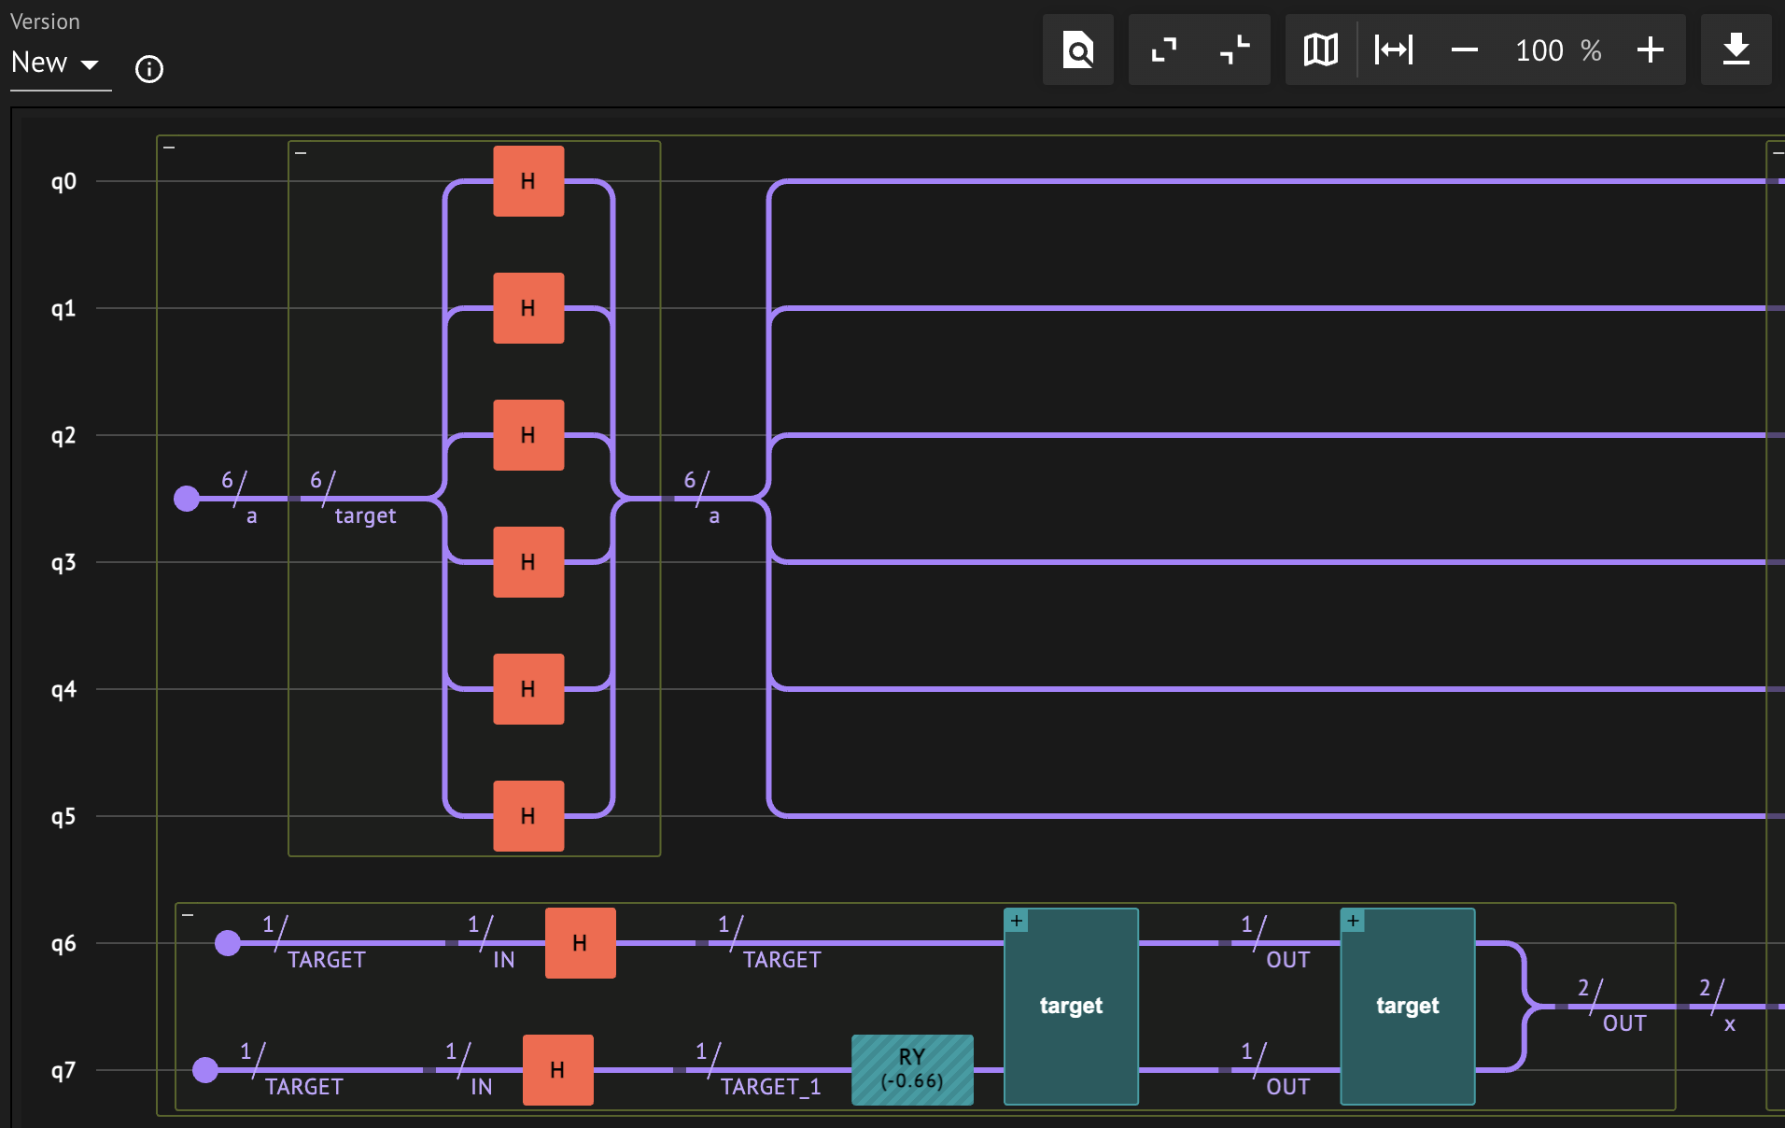
RODEO Implementation
Implementation Intro
High level code
Quantum circuit

Slide 35
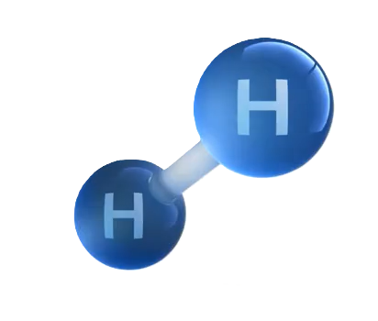
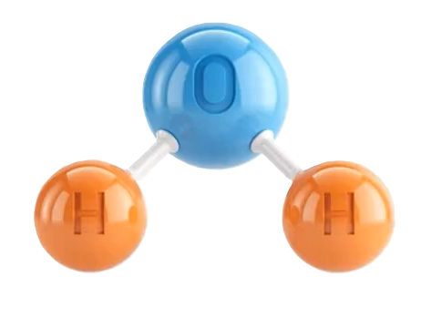
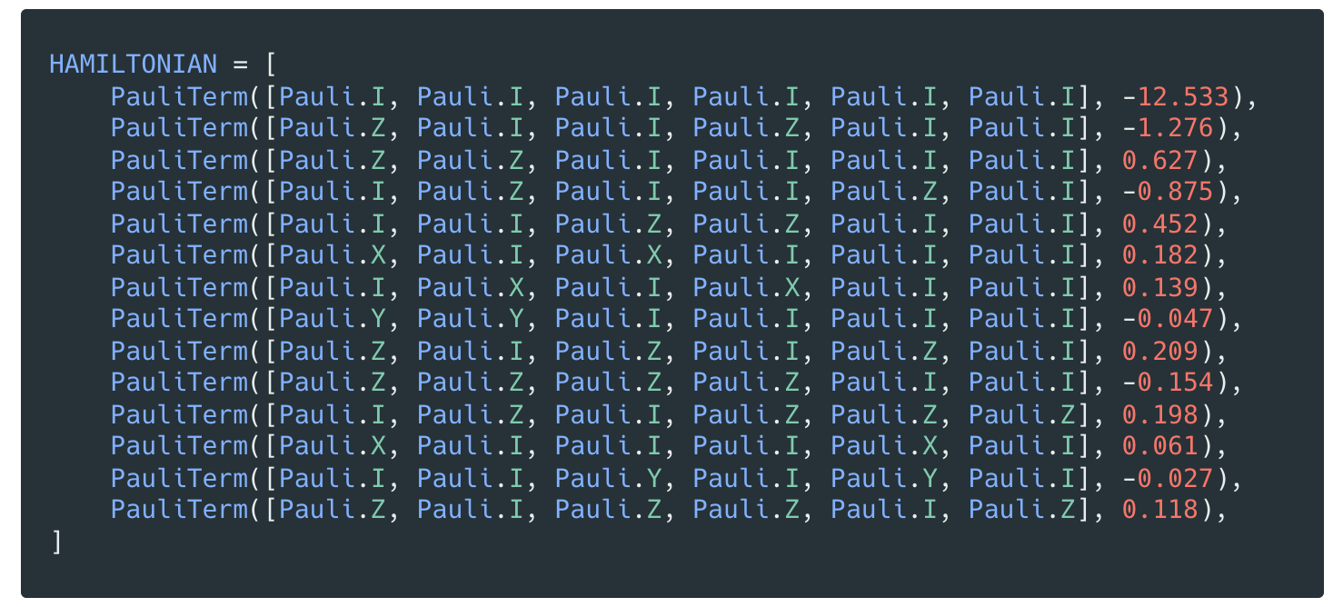
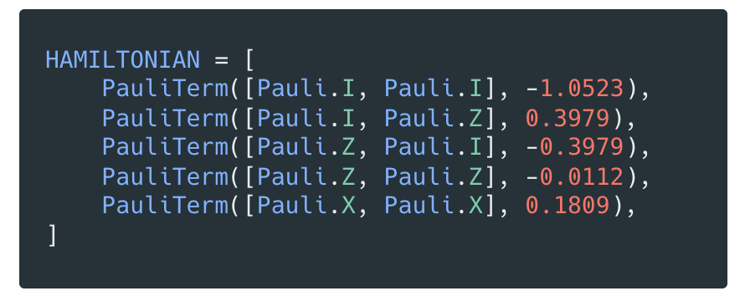
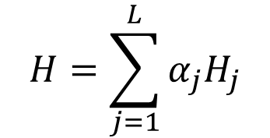
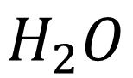
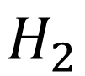
RODEO Implementation
Test-case
$$H_{2}$$
$$H=\sum_{j=1}^{L}{α_{j}H_{j}}$$
$$H_{2}O$$

Slide 36


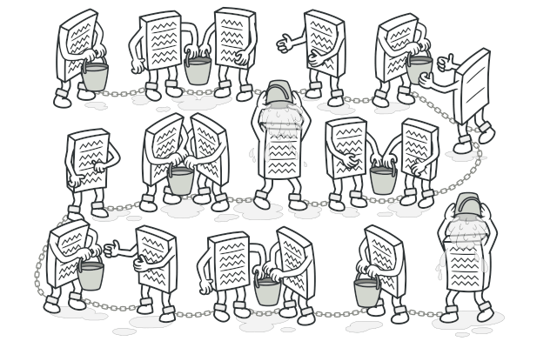


RODEO Implementation
Setup and Strategy
Design Pattern
language
Chain of responsability
platform
IDE
VCS
https://github.com/Los-Pollos-Quanticos/PushQuantumHackaton2024

Slide 37
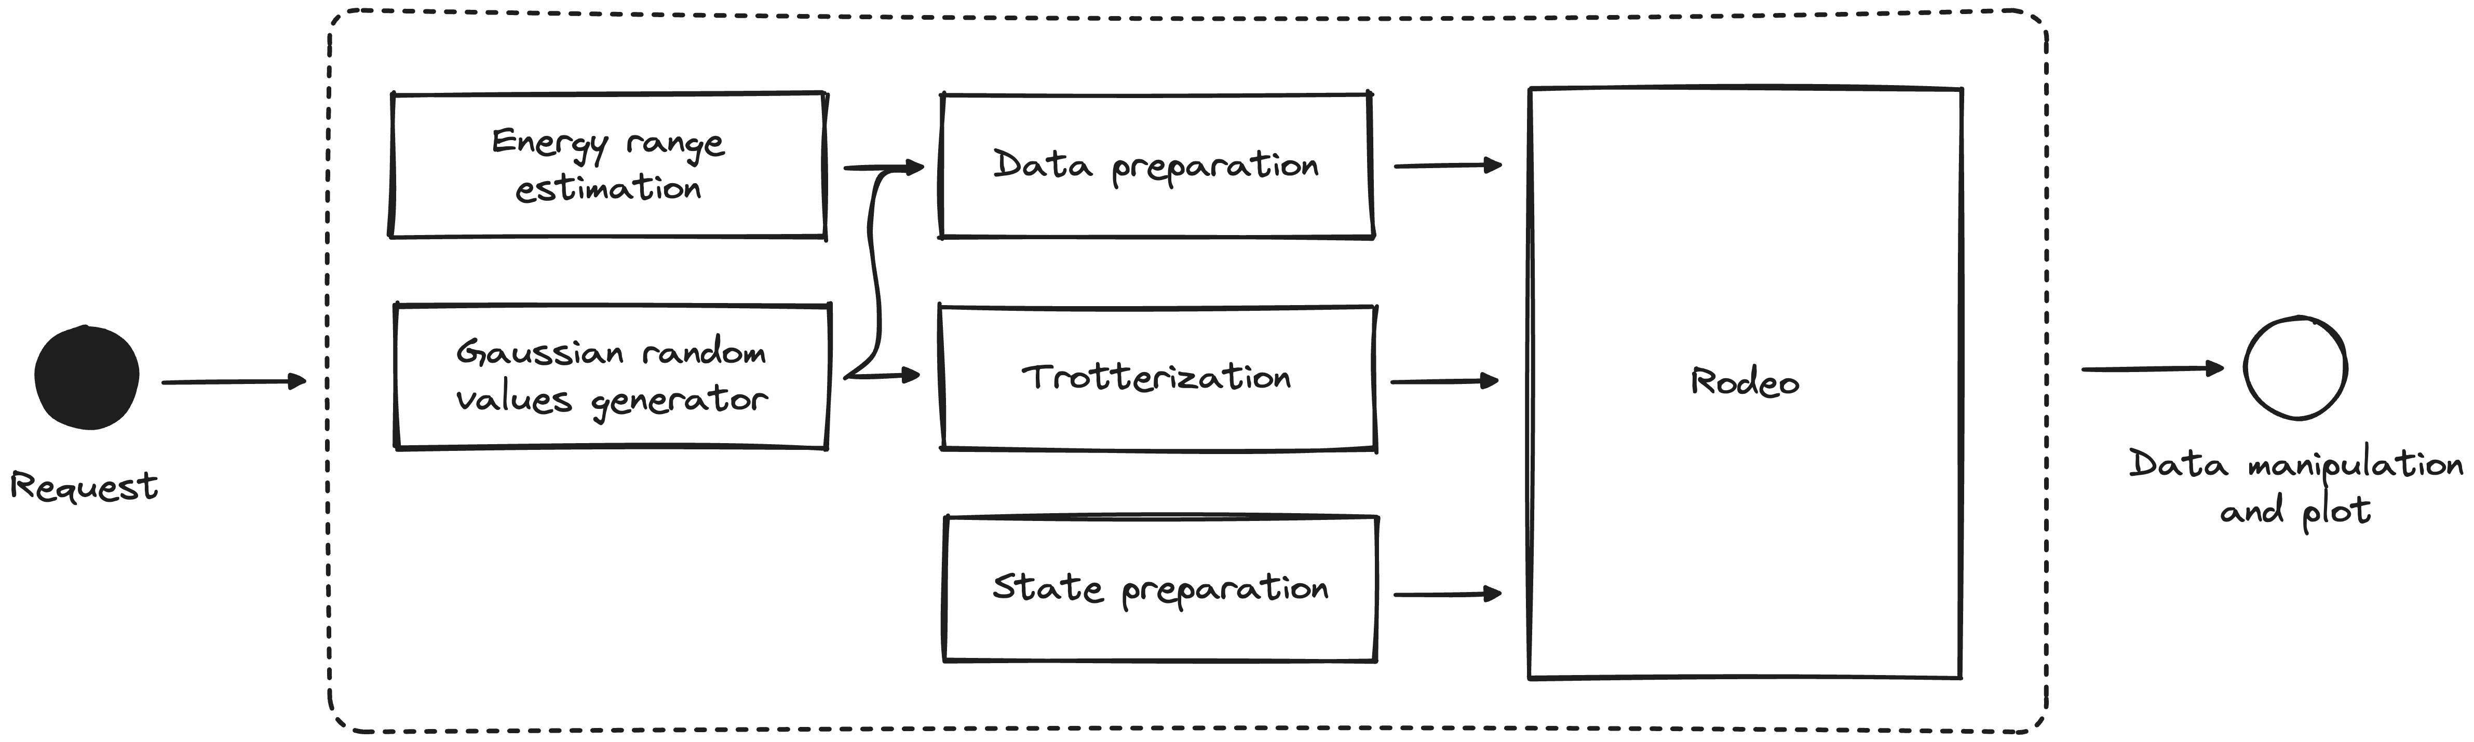
RODEO Implementation
Code structure

Slide 38
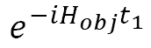



RODEO Implementation
Suzuki-Lie Trotter
Rodeo
$$H=\sum_{j=1}^{L}{α_{j}H_{j}}$$
$$e^{−iH_{obj}t_{1}}$$
$$e^{−iH_{obj}t_{2}}$$
$$e^{−iH_{obj}t_{n}}$$

Slide 39






RODEO Implementation
Suzuki-Lie Trotter
product formula
$$H=\sum_{j=1}^{L}{α_{j}H_{j}}$$
$$e^{−i\sum_{j=1}^{L}{α_{j}H_{j}}t}$$
$$e^{−i{α_{1}H}_{1}t}$$
$$e^{−i{α_{2}H}_{2}t}$$
$$e^{−iα_{L}H_{L}t}$$
$$H_{j}$$
are non-commuting terms

Slide 40












RODEO Implementation
Suzuki-Lie Trotter
Suzuki-Lie Trotter
$$H=\sum_{j=1}^{L}{α_{j}H_{j}}$$
$$\sim$$
$$e^{−i{α_{2}H}_{2}\frac{t}{r}}$$
$$e^{−iα_{L}H_{L}\frac{t}{r}}$$
$$e^{−i\sum_{j=1}^{L}{α_{j}H_{j}}t}$$
$$\sim$$
$$e^{−i{α_{1}H}_{1}\frac{t}{r}}$$
$$O\left(\frac{{\left(LΛt\right)}^{2}}{r}\right)$$
r times
$$Λ ≔\max_{j}{α_{j}}$$
$$L:\# of terms$$
$$t:evolution time$$
$$r: \# of repetition$$

Slide 41









RODEO Implementation
$$P_{A}(E)= \prod_{n=1}^{A}{\cos^{2}\left[\frac{\left(E_{i}−E\right)t_{n}}{2}\right]}$$
$${\left|\left\langle Ψ | ψ_{i}\right\rangle \right|}^{2}=p= \frac{1}{N}$$
Rodeo Test
$$\left[E_{0},E_{N−1}\right]$$
$$P_{A}$$
A=6, TRMS=7, SAMPLES=100

Slide 42

RODEO Implementation
OK!
Now we know that our algorithm works!
THIS GUY CAN HELP US!
…BUT…
HOW DO WE CHOOSE THE ENERGY RANGE PROPERLY?
HOW DO WE SET THE INITIAL STATE?

Slide 43
RODEO Implementation
OK!
Now we know that our algorithm works!
THIS GUY CAN HELP US!
…BUT…
HOW DO WE CHOOSE THE ENERGY RANGE PROPERLY?
HOW DO WE SET THE INITIAL STATE?

Slide 44


RODEO Implementation
Gershgoring Circle Theorem
$■$ Hypothesis: let A be a complex n x n matrix with entries $a_{ij}.$ For i $∈\left\{1….n\right\}$ let $R_{i}$ be the sum of the modulus of the non diagonal entries in the i-th row:
$$R_{i}=Σ_{j≠i}|a_{ij}|$$
Let $D\left(a_{ii}, R_{i}\right) ⊆ ℂ$ be a closed disk centered at $a_{ii}$ with radius $R_{i}$. Such a disk is called a Gershgorin disk.
$■$Statement: every eigenvalue of A lies within at least one of the Gershgoring disks $D\left(a_{ii}, R_{i}\right)$

Slide 45






RODEO Implementation
Gershgoring Circle Theorem: H2 Scenario
$$D_{0}(−1.0635, 0.1809)$$
[ -1.0635 0 0 0.1809 ]
[ 0 -1.8369 0.1809 0 ]
[ 0 0.1809 -0.2453 0 ]
[ 0.1809 0 0 -1.0635 ]
$$D_{2}(−0.2453, 0.1809)$$

Slide 46





RODEO Implementation
Gershgoring Circle Theorem: Initial state selection
Solution:
Key remarks:
The input state for the RODEO will be the computational basis state corresponding to the row index.
Each Gershgorin disk corresponds to a row of the Hamiltonian.
The Hamiltonian is diagonally dominant!
Benefits:
This ensures a nonzero overlap between input state and associated eigenstate, filtering the desired eigenvalue in the Rodeo algorithm.
$$|00⟩$$
[ -1.0635 0 0 0.1809 ]
[ 0 -1.8369 0.1809 0 ]
[ 0 0.1809 -0.2453 0 ]
[ 0.1809 0 0 -1.0635 ]
$$|01⟩$$
$$|11⟩$$
This approach narrows the energy search range within the bounds of each disk.
$$|10⟩$$

Slide 47


RODEO Implementation
Gershgoring Circle Theorem: H2 results
$■$ Input state |00>
[-1.0635 0 0 0.1809 ]
[ 0 -1.8369 0.1809 0 ]
[ 0 0.1809 -0.2453 0 ]
[ 0.1809 0 0 -1.0635 ]
|00> State

Slide 48


RODEO Implementation
Gershgoring Circle Theorem: H2 results
$■$ Input state |11>
[-1.0635 0 0 0.1809 ]
[ 0 -1.8369 0.1809 0 ]
[ 0 0.1809 -0.2453 0 ]
[ 0.1809 0 0 -1.0635 ]
|11> State

Slide 49


RODEO Implementation
Gershgoring Circle Theorem: H2 results
$■$ Input state |01>
[-1.0635 0 0 0.1809 ]
[ 0 -1.8369 0.1809 0 ]
[ 0 0.1809 -0.2453 0 ]
[ 0.1809 0 0 -1.0635 ]
|01> State

Slide 50


RODEO Implementation
Gershgoring Circle Theorem: H2 results
$■$ Input state |10>
[-1.0635 0 0 0.1809 ]
[ 0 -1.8369 0.1809 0 ]
[ 0 0.1809 -0.2453 0 ]
[ 0.1809 0 0 -1.0635 ]
|10> State

Slide 51

RODEO Implementation
Gershgoring Circle Theorem: H20 Scenario
Pathologic situation
Task: Find the 5 lowest eigenvalues of the H20 molecule
Calculation and plot of the Gergshgoring disks.
Recognition of corresponding computational basis state to give as input for Rodeo Algorithm.

Slide 52




RODEO Implementation
Gershgoring Circle Theorem: H20 Scenario
Main problem:
Overlapping Gershgorin disks can lead to unknown eigenvalue order.
The lowest eigenvalues do not necessarily align with the first disks in the E axis.
Strategy
Sort all Gershgoring disks by their lower bound.
Start with the first disk “A” and collect all overlapping disk.
Move to the next non overlapping disk “B” and repeat the collection process.
Stop when five disks are collected.

Slide 53



RODEO Implementation
Gershgoring Circle Theorem: H20 Results
N = 4, RMS = 7: the eigenvalue peak is distinguishable from minor ones.
Other small peaks appear just due to the periodicity of $P_{N}\left(E\right)$.
State corresponding to row 36: |100100>

Slide 54

RODEO Implementation
Gershgoring Circle Theorem: H20 Results
N = 4, RMS = 7: the eigenvalue peak is distinguishable from minor ones.
Other small peaks appear just due to the periodicity of $P_{N}\left(E\right)$.
State corresponding to row 37: |100101>

Slide 55

RODEO Implementation
Gershgoring Circle Theorem: H20 Results
N = 4, RMS = 7: the eigenvalue peak is distinguishable from minor ones.
Other small peaks appear just due to the periodicity of $P_{N}\left(E\right)$.
State corresponding to row 27: |011011>

Slide 56

RODEO Implementation
Gershgoring Circle Theorem: H20 Results
N = 4, RMS = 7: the eigenvalue peak is distinguishable from minor ones.
Other small peaks appear just due to the periodicity of $P_{N}\left(E\right)$.
State corresponding to row 26: |011010>

Slide 57

RODEO Implementation
Gershgoring Circle Theorem: H20 Results
N = 4, RMS = 7: the eigenvalue peak is distinguishable from minor ones.
Other small peaks appear just due to the periodicity of $P_{N}\left(E\right)$.
Results show that 5 lowest eigenvalues did correspond to the first five Gershgoring disks.
State corresponding to row 19: |010011>

Slide 58
Variational Quantum Deflation (VQD)

Slide 59







VQD
Brief recall of VQE
Initial state
$$|ψ_{init}⟩$$
Trial
Wavefunction
$$\left|ψ_{trial}\right\rangle =U\left(θ,ω,φ\right)|ψ_{init}⟩$$
Ansatz circuit
$$U(θ,ω,φ)$$
Exploit the variational principle
$$E_{VQE}=\min_{θ}{⟨ψ_{trial}\left|H\right|ψ_{trial}⟩}≥E_{0}$$
$$|E_{0}⟩$$
Classical Optimizer
Observable
$$H=∑E_{i}P_{i}$$
$$|ψ_{out}⟩$$
Notes:
Hybrid algorithm based on the variational principles that provides an upper bound for the lowest expectation value with respect to a trial wave function

Slide 60





VQD
Legenda:
$\left\{θ_{j},ω_{j}, φ_{j}\right\}$ VQE parameters
$P_{i}=|ψ_{i}⟩⟨ψ_{i}|$ Projector
$β_{i}$ Penalty
k total number of states
Building the spectra: the idea [HO19]
while(i<k-1)
New objective
$$H_{i+1}≔H_{i}+β_{i}P_{i}$$
VQE
$${\left\{θ_{j}, ω_{j},φ_{j}\right\}}_{j=0}^{n}$$
$$H_{obj}$$
$\left|ψ_{i}\right\rangle$, $E_{i}$
Optimizer

Slide 61










VQD
Energy
How to choose the penalties
$$E_{k−1}$$
$$E_{k−2}$$
The penalty must be chosen such that, if we are at stage k, then
…
$$Δ$$
$$E_{2}$$
$$β_{k−1}+E_{k−1}>E_{k}$$
$$E_{0}$$
$$β_{0}$$
$$E_{1}$$
So that $\left|ψ_{k}\right\rangle$ is the new ground state.
$$E_{0}$$

Slide 62

VQD
implementation intro
Ansatz circuit
$$U(θ,ω,φ)$$
Cost function
Classical Optimizer
Optimized parameters
Notes:
Rot ->

Slide 63





VQD
Ansatz – encoding circuit
System with N features
Amplitude Encoding
Angle Encoding
Basis Encoding
$$\log_{2}{N} qubits$$
$$N qubits$$
$$N×M qubits$$
$$\text{M} \text{is} \text{the} \text{number} \text{of} \text{bits} \text{in} \text{the} \text{binary} \text{string}$$
exponential number of transformations
linear
number of transformations
direct encoding into the computational basis
Notes:
Rot ->

Slide 64




VQD
Ansatz – entangling layer
Basic Entangler Layer
Strongly Entangling Layer
one-parameter $θ$
single-qubit rotations
ROT gate
Images taken from IEEE 10.1109/ACCESS.2024.3432312
Notes:
Rot ->

Slide 65




VQD
The ansatz
Single layer
Parametric number of layers
Parameters to be optimized: $N×L×3$
N$:\# of qubits to represent the state$
L$:\# of layer of the circuit$
Notes:
Rot ->

Slide 66


VQD
Optimizer
An optimizer is an algorithm used to find the parameters that minimize (or maximize) a given function, called a cost function
Adam (Adaptive Moment)
Adaptive learning
Momentum

Slide 67

VQD
Optimizer – Toy model
Adam (Adaptive Moment Estimation)
Parameters:
- Starting point
- Cost function
- Tolerance
- Step size

Slide 68



VQD
Results: VQD for H2
6 ansatz layer
Tolerance = ${10}^{−6}$
Penalty = 2 eV
Max iterations = 200

Slide 69


VQD
Results: VQD for H2O
6 ansatz layer
Tolerance = ${10}^{−6}$
Penalty = 2 eV
Max iterations = 200

Slide 70
Comparison: RODEO vs VQD

Slide 71




Comparison: RODEO vs VQD
H2 Eigenvalue Computation Error
$T_{RMS}$ = 7
6 ansatz layer.
N = 4
Energy range taken from Gershgoring.
Tolerance = ${10}^{−6}$
Penalty = 2eV
60 interrogation points for each range.
Iterations = 200

Slide 72


Comparison: RODEO vs VQD
H2 Eigenvalue Execution Time: VQD VS RODEO
$T_{RMS}$ = 7
6 ansatz layer.
N = 4
Energy range taken from Gershgoring.
Tolerance = ${10}^{−6}$
Penalty = 2eV
60 interrogation points for each range.
Iterations = 200

Slide 73


Comparison: RODEO vs VQD
H2O Eigenvalue Computation Error: VQD VS RODEO
$T_{RMS}$ = 7
6 ansatz layer.
N = 4
Energy range taken from Gershgoring.
Tolerance = ${10}^{−6}$
Penalty = 2eV
50 interrogation points for each range.
Iterations = 200

Slide 74


Comparison: RODEO vs VQD
H2O Eigenvalue Execution Time: VQD VS RODEO
$T_{RMS}$ = 7
6 ansatz layer.
N = 4
Energy range taken from Gershgoring.
Tolerance = ${10}^{−6}$
Penalty = 2eV
50 interrogation points for each range.
Iterations = 200

Slide 75
Conclusions

Slide 76

Conclusions
Summary
In this work we studied two NISQ quantum algorithms for molecular spectrum determination:
We compared their performance in determining the first eigenvalues of $H_{2}$ and $H_{2}O$ Hamiltonians
1- Rodeo algorithm, in combination with Gershgoring Circle Theorem, based on energy filtering through phase kickback
2- VQD, a modified VQE used to obtain also excited states’ eigenenergies through penalties
Result: VQD wins!
Notes:
Rot ->

Slide 77
THANK YOU FOR YOUR ATTENTION
Summary
In this work we studied two NISQ quantum algorithms for molecular spectrum determination:
We compared their performance in determining the first eigenvalues of $H_{2}$ and $H_{2}O$ Hamiltonians
1- Rodeo algorithm, in combination with Gershgoring Circle Theorem, based on energy filtering through phase kickback
2- VQD, a modified VQE used to obtain also excited states’ eigenenergies through penalties
Result: VQD wins!
Notes:
Rot ->

Slide 78
Conclusions
Summary
Gershgorin Circle
Theorem
RODEO
Molecular Hamiltonian
Comparison
VQD takes the win!
VQD
Hardware Efficient
Ansatz
Notes:
Rot ->

Slide 79
REFERENCES
[KR06]: Kempe, Julia, Alexei Kitaev, and Oded Regev. "The complexity of the local Hamiltonian problem." Siam journal on computing35.5 (2006): 1070-1097.
[CK21]: Choi, Kenneth, et al. "Rodeo algorithm for quantum computing." Physical Review Letters 127.4 (2021): 040505.
[HO19] Higgott, Oscar, Daochen Wang, and Stephen Brierley. "Variational quantum computation of excited states." Quantum3 (2019): 156.
Notes:
Rot ->

